Slide 1
Multi Layer Perceptron

Slide 2
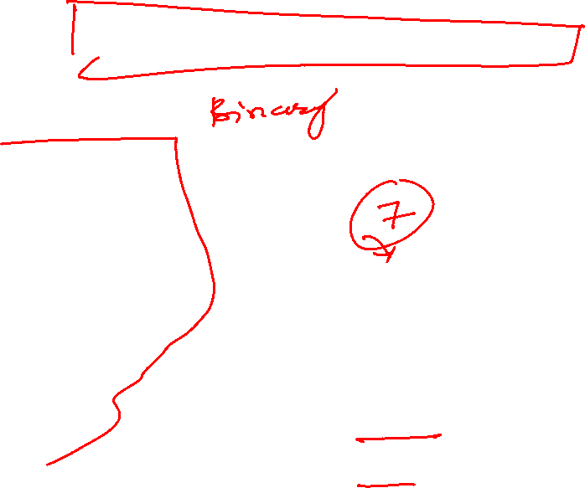
Threshold Logic Unit (TLU)
inputs
weights
x₁
w₁
output
w₂
activation
x₂
Σ
y
.
.
.
θ
a=Σ_{i=1}^{n} w_{i} x_{i}
w_{n}
x_{n}
1 if a ≥ θ
y=
0 if a < θ
{

Slide 3

Activation Functions
threshold
linear
y
y
a
a
piece-wise linear
sigmoid
y
y
a
a

Slide 4
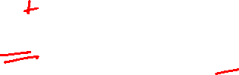
Decision Surface of a TLU
1
1
Decision line
w₁ x₁ + w₂ x₂ = θ
x₂
w
1
0
0
0
x₁
1
0
0

Slide 5
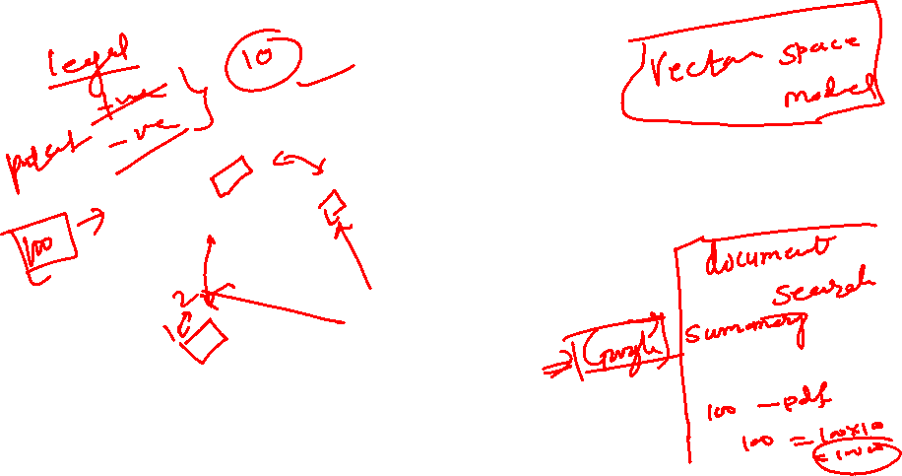
Geometric Interpretation
The relation w•x=θ defines the decision line
x₂
w
Decision line
y=1
w•x=θ
|x_{w}|=θ/|w|
x_{w}
x₁
x
y=0

Slide 6
Geometric Interpretation
In n dimensions the relation w•x=θ defines a n-1 dimensional hyper-plane, which is perpendicular to the weight vector w.
On one side of the hyper-plane (w•x>θ) all patterns are classified by the TLU as “1”, while those that get classified as “0” lie on the other side of the hyper-plane.
If patterns can be not separated by a hyper-plane then they cannot be correctly classified with a TLU.

Slide 7
Threshold as Weight
θ=w_{n+1}
x_{n+1}=-1
x₁
w₁
w_{n+1}
w₂
x₂
Σ
y
.
.
.
a= Σ_{i=1}^{n+1} w_{i} x_{i}
w_{n}
{
x_{n}
1 if a ≥ 0
y=
0 if a <0

Slide 8
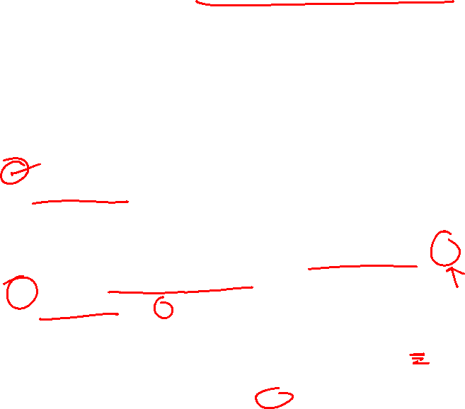
Training ANNs
Training set S of examples {x,t}
  x is an input vector and
  t the desired target vector
  Example: Logical And
  S = {(0,0),0}, {(0,1),0}, {(1,0),0}, {(1,1),1}
Iterative process
  Present a training example x , compute network output y , compare output y with target t, adjust weights and thresholds
Learning rule
  Specifies how to change the weights w and thresholds θ of the network as a function of the inputs x, output y and target t.

Slide 9

Perceptron Learning Rule
w’=w + α (t-y) x
Or in components
w’_{i} = w_{i} + Δw_{i} = w_{i} + α (t-y) x_{i} (i=1..n+1)
With w_{n+1} = θ and x_{n+1}=-1
The parameter α is called the learning rate. It determines the magnitude of weight updates Δw_{i} .
If the output is correct (t=y) the weights are not changed (Δw_{i} =0).
If the output is incorrect (t ≠ y) the weights w_{i} are changed such that the output of the TLU for the new weights w’_{i} is closer/further to the input x_{i}.

Slide 10
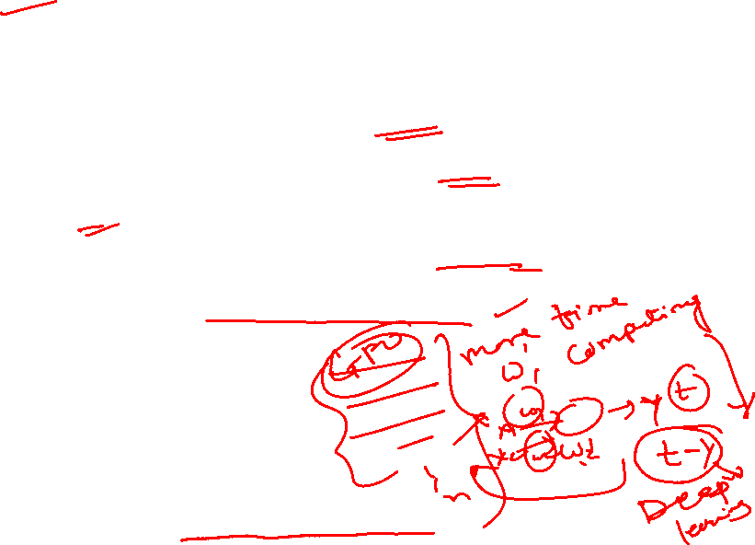
Perceptron Training Algorithm
Repeat
for each training vector pair (x,t)
evaluate the output y when x is the input
if y≠t then
form a new weight vector w’ according
to w’=w + α (t-y) x
else
do nothing
end if
end for
Until y=t for all training vector pairs

Slide 11
Applications of neural networks
Alvinn (the neural network that learns to drive a van from camera inputs).
NETtalk: a network that learns to pronounce English text.
Recognizing hand-written zip codes.
Lots of applications in financial time series analysis.

Slide 12
NETtalk (Sejnowski & Rosenberg, 1987)
The task is to learn to pronounce English text from examples.
Training data is 1024 words from a side-by-side English/phoneme source.
Input: 7 consecutive characters from written text presented in a moving window that scans text.
Output: phoneme code giving the pronunciation of the letter at the center of the input window.
Network topology: 7x29 inputs (26 chars + punctuation marks), 80 hidden units and 26 output units (phoneme code). Sigmoid units in hidden and output layer.

Slide 13
NETtalk (contd.)
Training protocol: 95% accuracy on training set after 50 epochs of training by full gradient descent. 78% accuracy on a set-aside test set.
Comparison against Dectalk (a rule based expert system): Dectalk performs better; it represents a decade of analysis by linguists. NETtalk learns from examples alone and was constructed with little knowledge of the task.

Slide 14
Overfitting
The training data contains information about the regularities in the mapping from input to output. But it also contains noise
  The target values may be unreliable.
  There is sampling error. There will be accidental regularities just because of the particular training cases that were chosen.
When we fit the model, it cannot tell which regularities are real and which are caused by sampling error.
  So it fits both kinds of regularity.
  If the model is very flexible it can model the sampling error really well. This is a disaster.

Slide 15
A simple example of overfitting
Which model do you believe?
  The complicated model fits the data better.
  But it is not economical
A model is convincing when it fits a lot of data surprisingly well.
  It is not surprising that a complicated model can fit a small amount of data.

Slide 16
Generalization
The objective of learning is to achieve good generalization to new cases, otherwise just use a look-up table.
Generalization can be defined as a mathematical interpolation or regression over a set of training points:
f(x)
x

Slide 17
Generalization
An Example: Computing Parity
Can it learn from m examples to generalize to all 2^n possibilities?
Parity bit value
+1
-1
+1
>0
>1
>2
(n+1)^2
weights
n bits of input
2^n possible examples

Slide 18
Generalization
Network test of 10-bit parity
(Denker et. al., 1987)
100%
When number of training cases,
m >> number of weights, then
generalization occurs.
Test
Error
0
.25
.50
.75
1.0
Fraction of cases used during training

Slide 19
Generalization
A Probabilistic Guarantee
N = # hidden nodes m = # training cases
W = # weights = error tolerance (< 1/8)
Network will generalize with 95% confidence if:
1. Error on training set <
2.
Based on PAC theory => provides a good rule of practice.

Slide 20
Generalization
The objective of learning is to achieve good generalization to new cases, otherwise just use a look-up table.
Generalization can be defined as a mathematical interpolation or regression over a set of training points:
f(x)
x

Slide 21
Generalization
Over-Training
Is the equivalent of over-fitting a set of data points to a curve which is too complex
Occam’s Razor (1300s) : “plurality should not be assumed without necessity”
The simplest model which explains the majority of the data is usually the best
Notes:
Show over-training OH

Slide 22
Generalization
Preventing Over-training:
Use a separate test or tuning set of examples
Monitor error on the test set as network trains
Stop network training just prior to over-fit error occurring - early stopping or tuning
Number of effective weights is reduced
Most new systems have automated early stopping methods

Slide 23
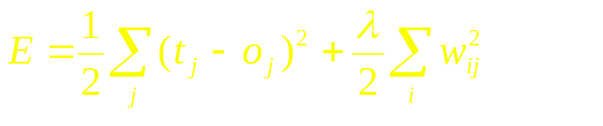
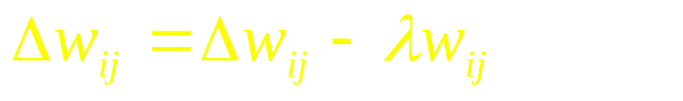
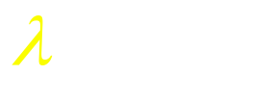

Generalization
Weight Decay: an automated method of effective weight control
Adjust the bp error function to penalize the growth of unnecessary weights:
where: = weight -cost parameter
is decayed by an amount proportional to its magnitude; those not reinforced => 0

Slide 24
Network Design & Training Issues
Design:
Architecture of network
Structure of artificial neurons
Learning rules
Training:
Ensuring optimum training
Learning parameters
Data preparation
and more ....

Slide 25
Network Design
Architecture of the network: How many nodes?
Determines number of network weights
How many layers?
How many nodes per layer?
  Input Layer Hidden Layer Output Layer
Automated methods:
  augmentation (cascade correlation)
  weight pruning and elimination

Slide 26
Network Design
Architecture of the network: Connectivity?
Concept of model or hypothesis space
Constraining the number of hypotheses:
  selective connectivity
  shared weights
  recursive connections
Notes:
Show 2 OHs of character recognition networks (from Hinton’s notes)

Slide 27
Network Design
Structure of artificial neuron nodes
Choice of input integration:
  summed, squared and summed
  multiplied
Choice of activation (transfer) function:
  sigmoid (logistic)
  hyperbolic tangent
  Guassian
  linear
  soft-max

Slide 28
Network Design
Selecting a Learning Rule
Generalized delta rule (steepest descent)
Momentum descent
Advanced weight space search techniques
Global Error function can also vary
  - normal - quadratic - cubic

Slide 29
Network Training
How do you ensure that a network has been well trained?
Objective: To achieve good generalization
accuracy on new examples/cases
Establish a maximum acceptable error rate
Train the network using a validation test set to tune it
Validate the trained network against a separate test set which is usually referred to as a production test set

Slide 30
Network Training
Approach #1: Large Sample
When the amount of available data is large ...
Available Examples
70%
Divide randomly
30%
Training
Set
Production
Set
Generalization error
= test error
Test
Set
Compute
Test error
Used to develop one ANN model

Slide 31
Network Training
Approach #2: Cross-validation
When the amount of available data is small ...
Available Examples
Repeat 10
times
90%
10%
Test
Set
Generalization error
determined by mean
test error and stddev
Training
Set
Pro.
Set
Used to develop 10 different ANN models
Accumulate
test errors

Slide 32
Network Training
How do you select between two ANN designs ?
A statistical test of hypothesis is required to ensure that a significant difference exists between the error rates of two ANN models
If Large Sample method has been used then apply McNemar’s test*
If Cross-validation then use a paired t test for difference of two proportions
*We assume a classification problem, if this is function
approximation then use paired t test for difference of means

Slide 33
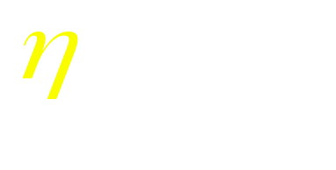
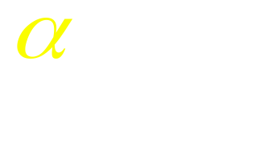
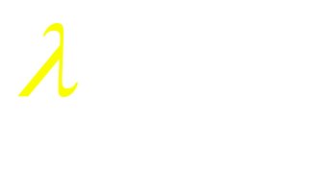
Network Training
Mastering ANN Parameters
Typical Range
learning rate - 0.1 0.01 - 0.99
momentum - 0.8 0.1 - 0.9
weight-cost - 0.1 0.001 - 0.5
Fine tuning : - adjust individual parameters at each node and/or connection weight
  automatic adjustment during training

Slide 34
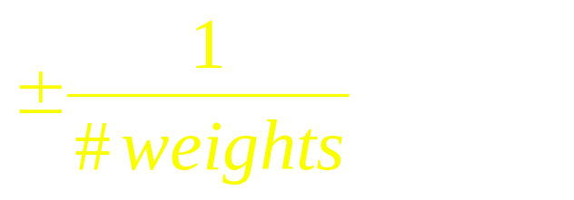
Network Training
Network weight initialization
Random initial values +/- some range
Smaller weight values for nodes with many incoming connections
Rule of thumb: initial weight range should be approximately
coming into a node

Slide 35
Network Training
Typical Problems During Training
E
Steady, rapid decline
in total error
Would like:
# iter
E
Seldom a local minimum - reduce learning or momentum parameter
But
sometimes:
# iter
E
Reduce learning parms.
- may indicate data is not learnable
# iter

Slide 36
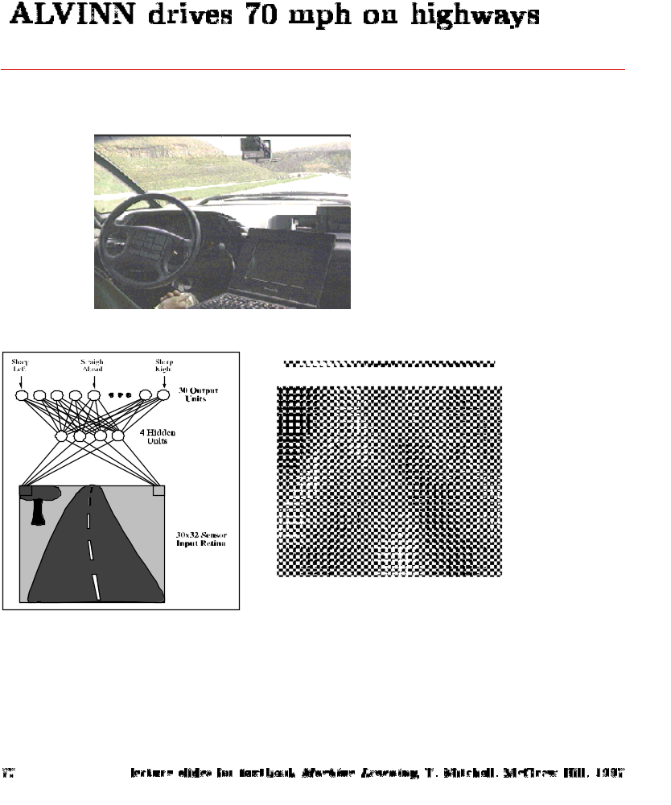
ALVINN
Automated driving at 70 mph on a public highway
Camera
image
30 outputs
for steering
30x32 weights
into one out of
four hidden
unit
4 hidden
units
30x32 pixels
as inputs

Slide 37
Perceptron vs. TLU
x₁
w₁
w₂
x₂
Σ
.
.
.
w_{n}
x_{n}
weights (trained)
fixed
Input
pattern
Association
units
Summation
Threshold
Association units (A-units) can be assigned arbitrary Boolean
functions of the input pattern.

Slide 38
Gradient Descent Learning Rule
Consider linear unit without threshold and continuous output o (not just –1,1)
  o=w₀ + w₁ x₁ + … + w_{n} x_{n}
Train the w_{i}’s such that they minimize the squared error
  E[w₁,…,w_{n}] = ½ Σ_{d∈D} (t_{d}-o_{d})²
  where D is the set of training examples

Slide 39
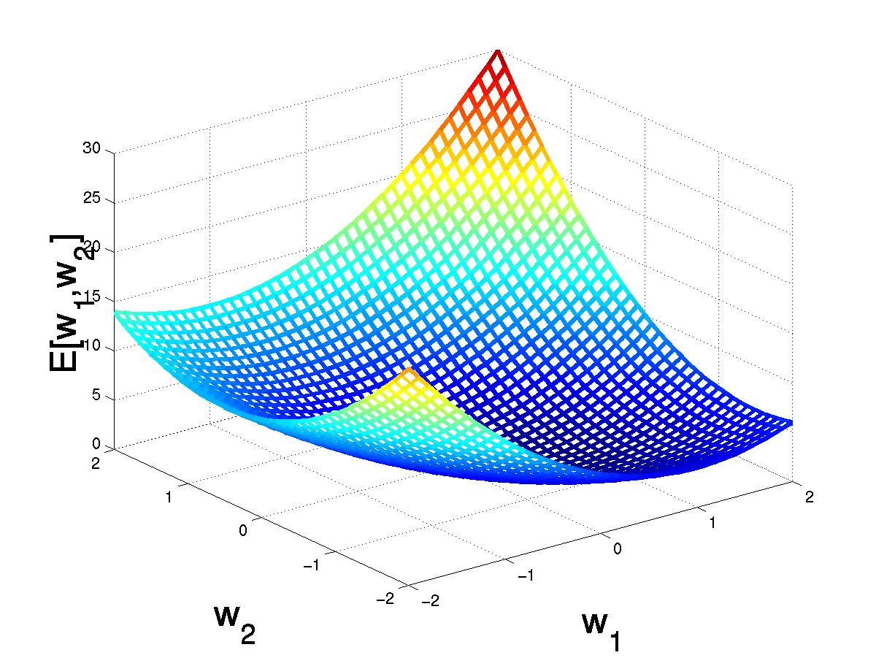
Gradient Descent
D={<(1,1),1>,<(-1,-1),1>,
<(1,-1),-1>,<(-1,1),-1>}
(w₁,w₂)
Gradient:
∇E[w]=[∂E/∂w₀,… ∂E/∂w_{n}]
Δw=-η ∇E[w]
(w₁+Δw₁,w₂ +Δw₂)
Δw_{i}=-η ∂E/∂w_{i}
=∂/∂w_{i} 1/2Σ_{d}(t_{d}-o_{d})²
= ∂/∂w_{i} 1/2Σ_{d}(t_{d}-Σ_{i} w_{i} x_{i})²
= Σ_{d}(t_{d}- o_{d})(-x_{i})

Slide 40
Gradient Descent
Gradient-Descent(training_examples, η)
Each training example is a pair of the form <(x₁,…x_{n}),t> where (x₁,…,x_{n}) is the vector of input values, and t is the target output value, η is the learning rate (e.g. 0.1)
Initialize each w_{i} to some small random value
Until the termination condition is met, Do
  Initialize each Δw_{i} to zero
  For each <(x₁,…x_{n}),t> in training_examples Do
    Input the instance (x₁,…,x_{n}) to the linear unit and compute the output o
    For each linear unit weight w_{i} Do
      Δw_{i}= Δw_{i} + η (t-o) x_{i}
  For each linear unit weight wi Do
    w_{i}=w_{i}+Δw_{i}

Slide 41
Literature
Neural Networks – A Comprehensive Foundation, Simon Haykin, Prentice-Hall, 1999
Networks for Pattern Recognition”, C.M. Bishop, Oxford University Press, 1996
”Neural Network Design”, M. Hagan et al, PWS, 1995
Perceptrons: An Introduction to Computational Geometry, Minsky, Papert, 1969

Slide 42
Software
Neural Networks for Face Recognition
http://www.cs.cmu.edu/afs/cs.cmu.edu/user/mitchell/ftp/faces.html
SNNS Stuttgart Neural Networks Simulator
http://www-ra.informatik.uni-tuebingen.de/SNNS
Neural Networks at your fingertips
http://www.geocities.com/CapeCanaveral/1624/
Neural Network Design Demonstrations
http://ee.okstate.edu/mhagan/nndesign_5.ZIP
Bishop’s network toolbox
Matlab Neural Network toolbox

Slide 43
A change of notation
For simple networks we use the notation
  x for activities of input units
  y for activities of output units
  z for the summed input to an output unit
For networks with multiple hidden layers:
  y is used for the output of a unit in any layer
  x is the summed input to a unit in any layer
  The index indicates which layer a unit is in.

Slide 44
First MLP Exercise (Due June 19)
Become familiar with the Neural Network Toolbox in Matlab
Construct a single hidden layer, feed forward network with sigmoidal units. to output. The network should have n hidden units n=3 to 6.
Construct two more networks of same nature with n-1 and n+1 hidden units respectively.
Initial random weights are from ~ N(µ,σ²)
The dimensionality of the input data is d
Notes:
Constructing the a train and test set: of M samples chosen from

Slide 45
First MLP Exercise (Cntd)
Constructing the a train and test set of size M
For simplicity, choose two distributions N(-1, σ²) and N(1, σ²). Choose M/2 samples of d dimensions from the first distribution and M/2 from the second. This way you get a set of M vectors in d dimensions. Give the first set a class label of 0 and the second set a class label of 1.
Repeat this again for the construction of the test set.

Slide 46
Actual Training
Train 5 networks with the same training data (each network has different initial conditions)
Construct a classification error graph for both train and test data taken at different time steps (mean and std over 5 nets)
Repeat for n=3-6 using both n+1 and n-1
Discuss the results, justify with graphs and provide clear understanding
(you may try other setups to test your understanding)
Consider momentum and weight deca

Slide 47
Generalization
An Example: Computing Parity
Can it learn from m examples to generalize to all 2^n possibilities?
Parity bit value
+1
-1
+1
>0
>1
>2
(n+1)^2
weights
n bits of input
2^n possible examples

Slide 48
Generalization
Network test of 10-bit parity
(Denker et. al., 1987)
100%
When number of training cases,
m >> number of weights, then
generalization occurs.
Test
Error
0
.25
.50
.75
1.0
Fraction of cases used during training

Slide 49
Generalization
Consider 20-bit parity problem:
20-20-1 net has 441 weights
For 95% confidence that net will predict with , we need
training examples
Not bad considering
Notes:
Parity is one of the most difficult problems to learn strictly by example using any method.
It is, in fact, the XOR problem generalized to n bits.
NOTE: most real-world processes/functions which are learnable are not this difficult.
It should also be noted that certain sequences of events or random bit patterns cannot be modeled (example: weather - Kolmogorov showed that compressibility of a sequence is an indicator of its ability to be modeled.
Interesting fact:
(1) consider pie .. probability of compression is 1 -it can be compressed to a very small algorithm, yet its limit is unknown (a transcendental number)
(2) consider a series of 100 random numbers between 1 and 1000 .. probability of compression is less than 1%.
Always consider: It is possible that certain factors effecting a process
may be non-deterministic, in which case the best model will be an approximation

Slide 50
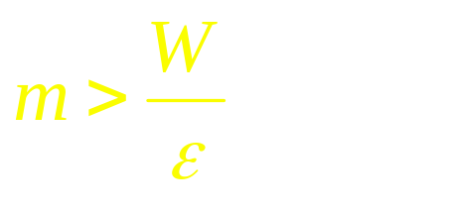
Generalization
Training Sample & Network Complexity
Based on :
W - to reduced size
of training sample
Optimum W=> Optimum #
Hidden Nodes
W - to supply freedom
to construct desired function

Slide 51
Generalization
How can we control number of effective weights?
Manually or automatically select optimum number of hidden nodes and connections
Prevent over-fitting = over-training
Add a weight-cost term to the bp error equation

Slide 52
Generalization
Consider 20-bit parity problem:
20-20-1 net has 441 weights
For 95% confidence that net will predict with , we need
training examples
Not bad considering
Notes:
Parity is one of the most difficult problems to learn strictly by example using any method.
It is, in fact, the XOR problem generalized to n bits.
NOTE: most real-world processes/functions which are learnable are not this difficult.
It should also be noted that certain sequences of events or random bit patterns cannot be modeled (example: weather - Kolmogorov showed that compressibility of a sequence is an indicator of its ability to be modeled.
Interesting fact:
(1) consider pie .. probability of compression is 1 -it can be compressed to a very small algorithm, yet its limit is unknown (a transcendental number)
(2) consider a series of 100 random numbers between 1 and 1000 .. probability of compression is less than 1%.
Always consider: It is possible that certain factors effecting a process
may be non-deterministic, in which case the best model will be an approximation

